Slide 1
DEATH RATE FINDER
Ashwini Giri
Isha Patil

Slide 2
Functionalities
Web application to search information about death rate based on state.
Search can be filtered based on cause of death, year of death and number of deaths.
Data stored on google firebase cloud storage.
User login, signup and logout using the email authentication provided by firebase.
Save searches for future reference.
Contact Us page for addressing user queries.

Slide 3
Workflow
.
Data processing and
Storage
Implementing keyword search
User Interface
Implementing Save search
User authentication
Implementing 3 search filters

Slide 4
Programming Languages
Python : data transformation from csv to json. Creating inverted index on state attribute for easy keyword search. Restful API to upload the data to firebase
HTML: To develop web pages
CSS: Styling of the web pages
JavaScript: For interaction of firebase and web pages

Slide 5
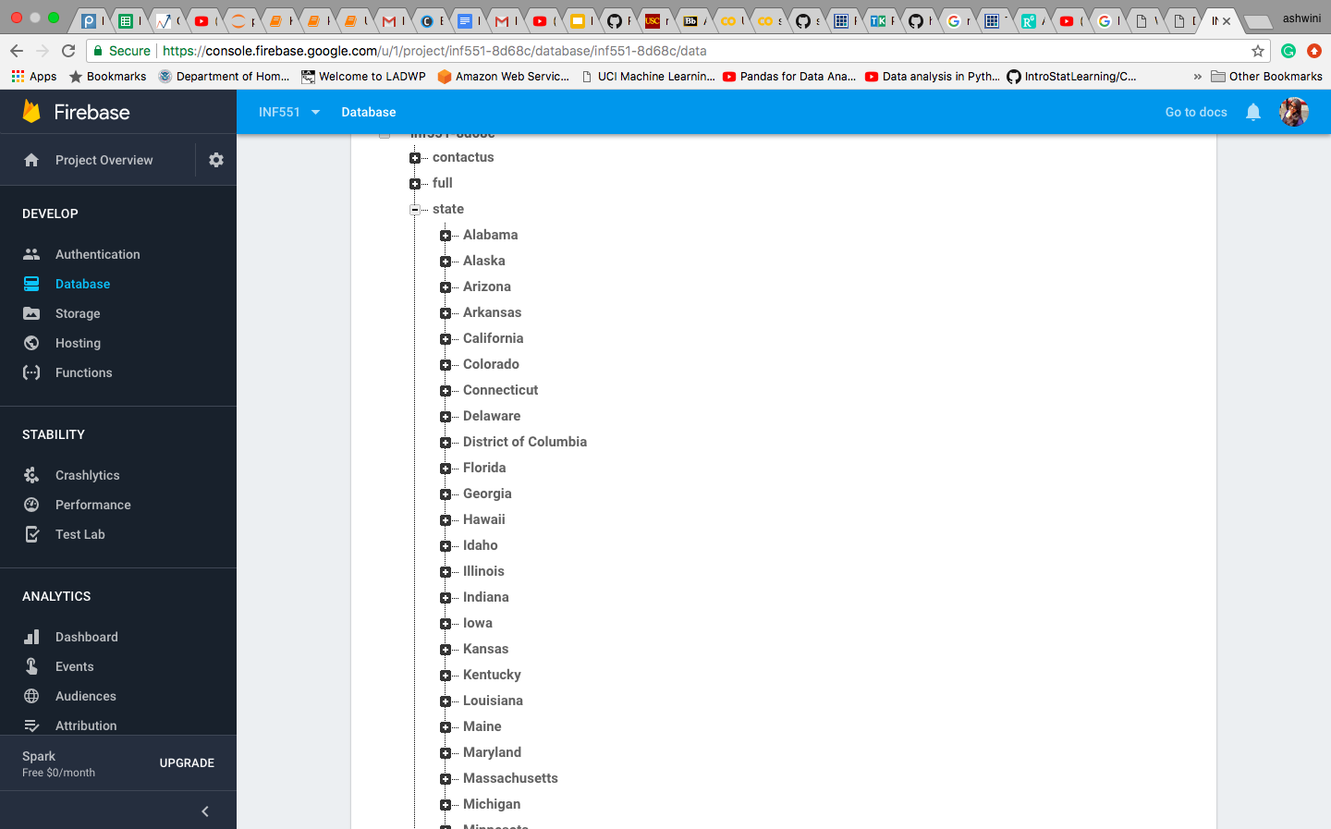
Data Analysis
The death data is fetched from https://catalog.data.gov/dataset/age-adjusted-death-rates-for-the-top-10-leading-causes-of-death-united-states-2013
The data is stored in firebase in the form of nodes and keys for easy access and search.
Created an inverted index on the state of death for implementation of search functionality.
ATTRIBUTES
Year
Cause name
Number of deaths
Age adjusted death rate
Scientific cause name
State of death occurrence
Facets
Keyword search

Slide 6

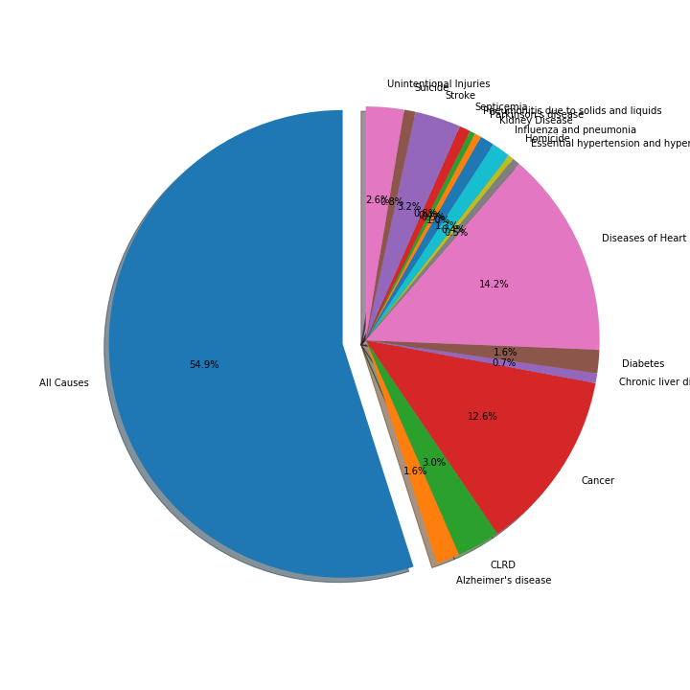
Some Data Inferences
Deaths by cause

Slide 7
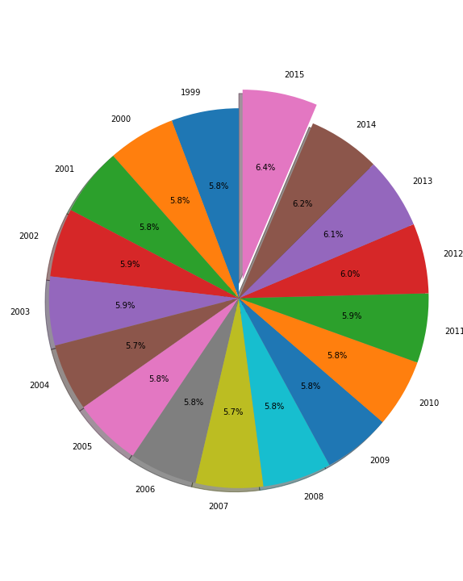
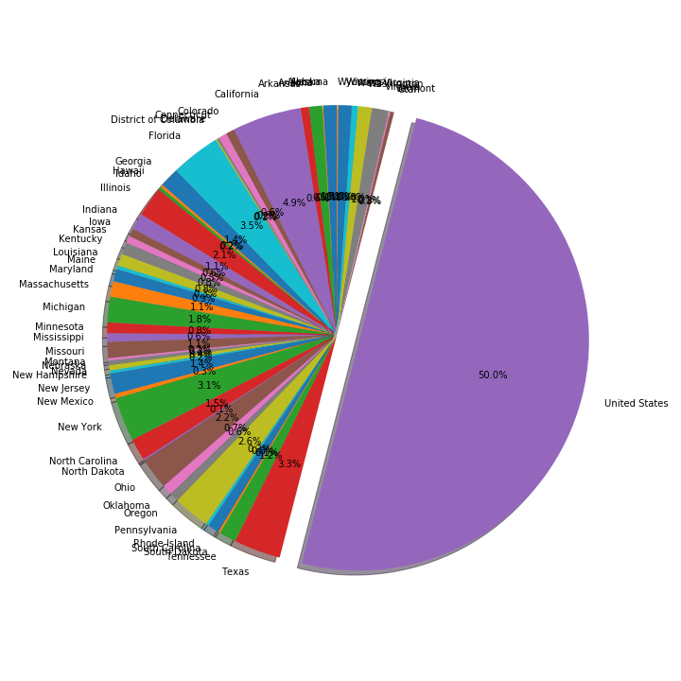
Deaths by years
Deaths by states

Slide 8

Home page & UI
Provided login and signup on the homepage.
The contact us page can also be addressed from the homepage.
The UI is implemented using basic HTML, CSS and JavaScript functions.

Slide 9
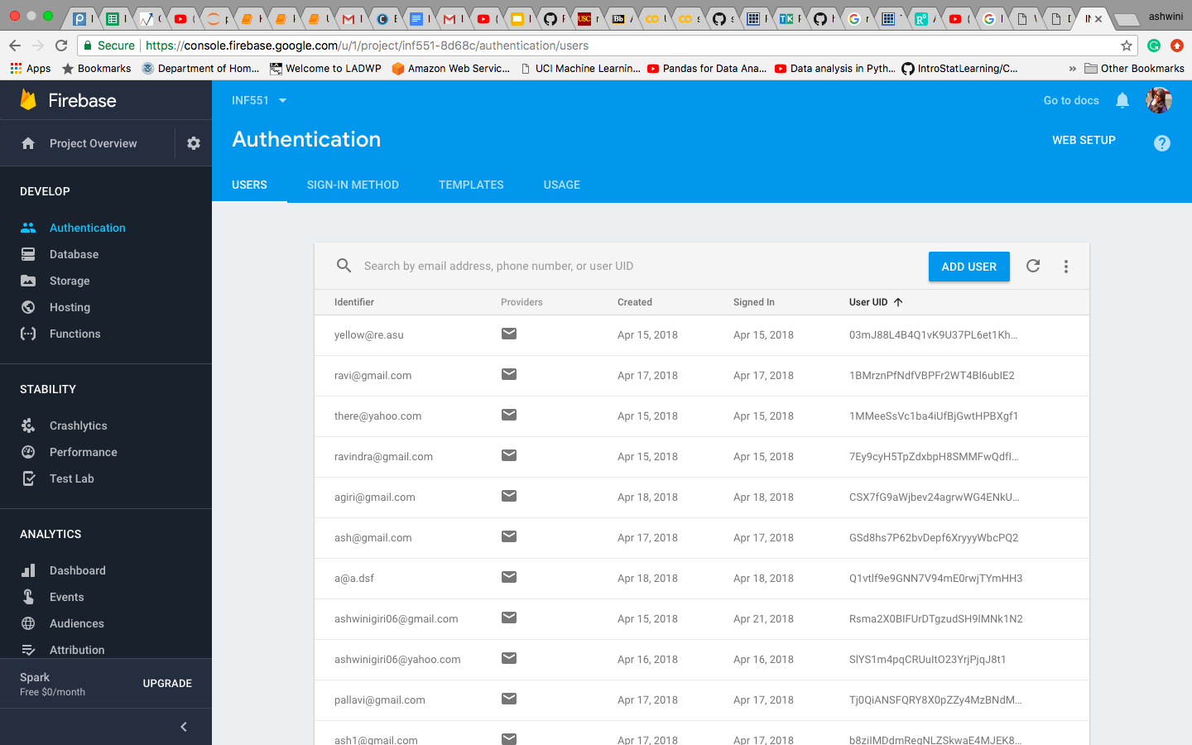
User Authentication
Users are authenticated using the email authentication provided by firebase.

Slide 10
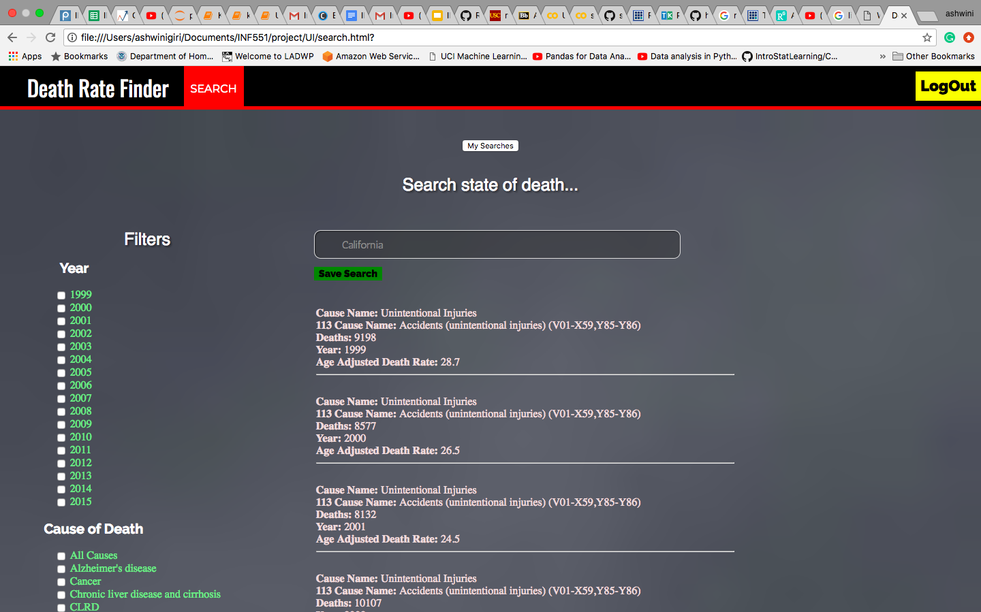
Faceted search
After user login the search provides 3 filters for data
Cause of death.
State of death.
Year of death/s.

Slide 11
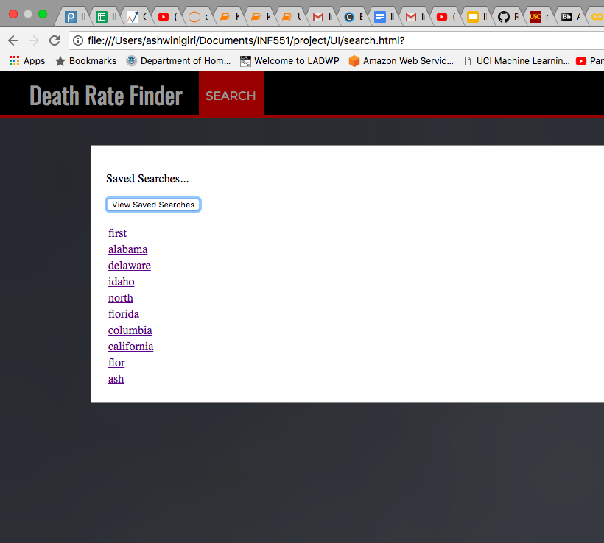
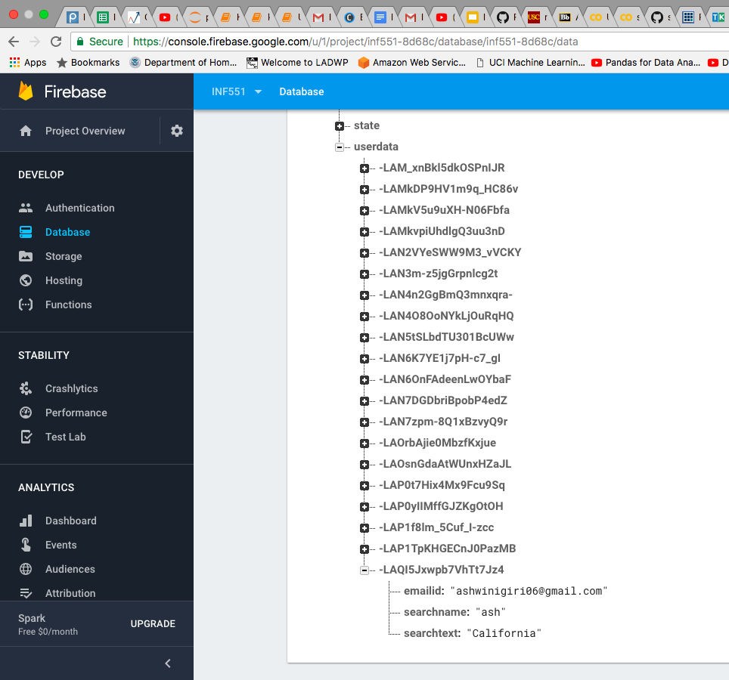
Save User Search History
The current logged in user can save the search and also retrieve already saved searches.
User’s search history is saved on firebase database.

Slide 12
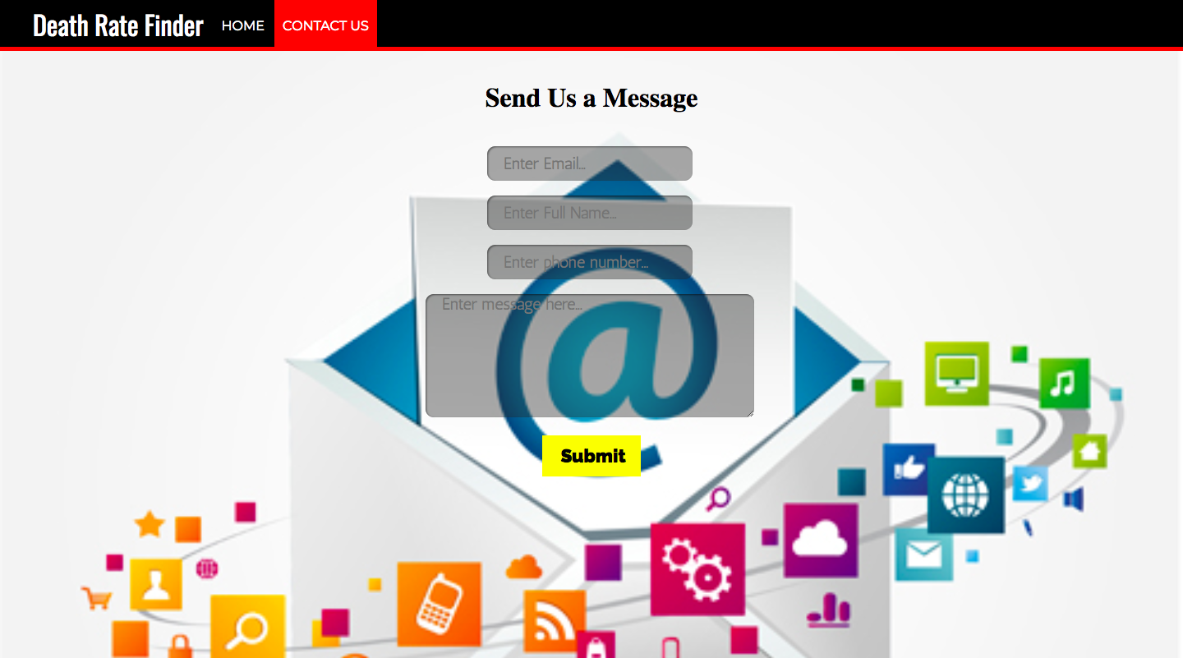
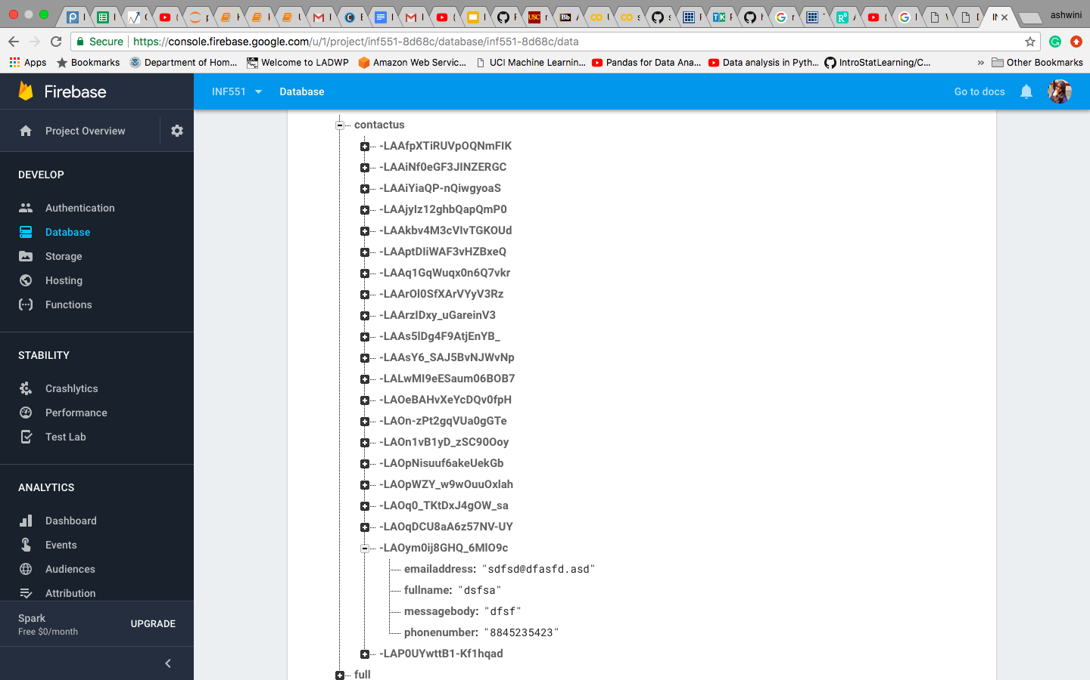
Contact Us
User can send their queries to the developer team.
Data is saved on firebase database.

Slide 13
Real World Use
Medical researchers may use this application for diagnosis.
Government may use the application for census monitoring and population information purposes (filter based on number of death)
Epidemiological surveys (filter based on cause of death)
The application may be used by general public for informative purposes
This application can be combined and used as a part of other applications.

Slide 14
THANK YOU !!

